Slide 1
Sentiment Analysis
Aspect-based
IST 557: Data Mining Project
Xiao Liu
Wenxiang Zheng
10/09/2014

Slide 2

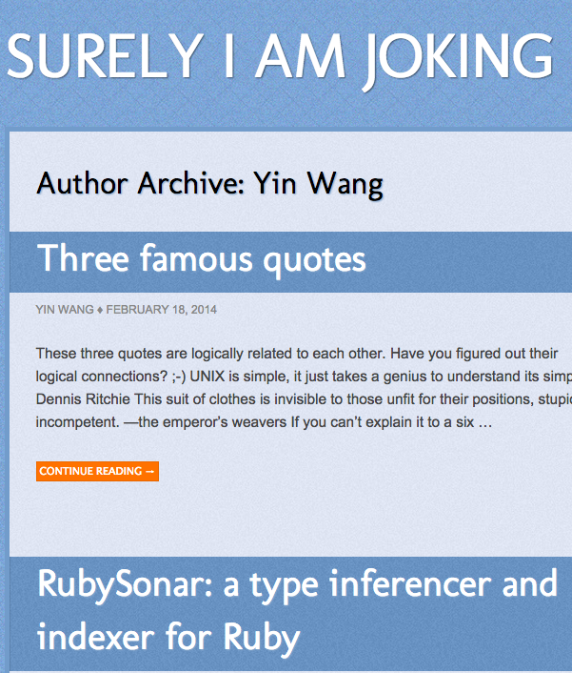
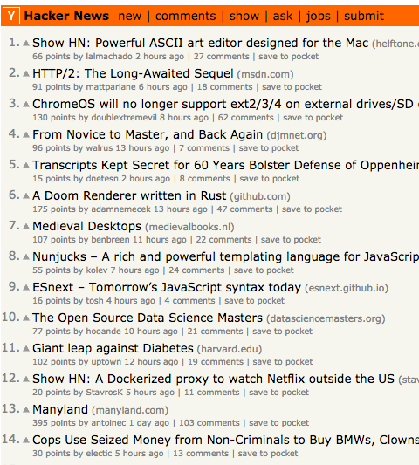
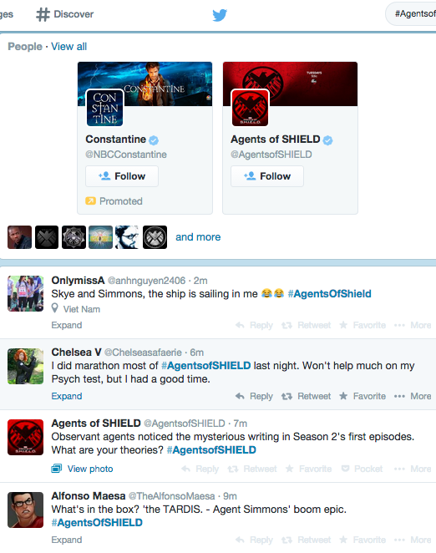
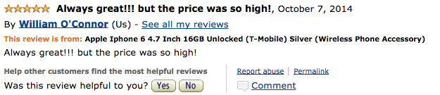
Introduction: What is Sentiment/Opinion?
Source
news blogs forums social network
reviews
Notes:
Reviews, blogs, discussions, news, comments, feedback, or any other documents

Slide 3
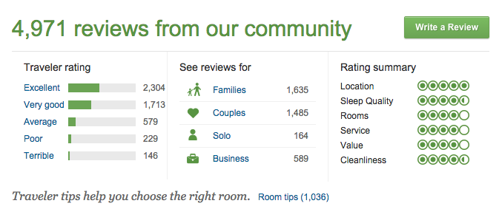
Introduction: What is Opinion Mining?

Slide 4
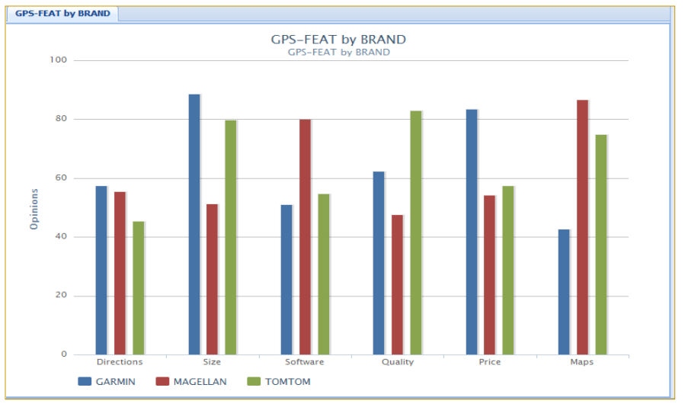
Introduction: What is Opinion Mining?
(OpinionEQ)
Notes:
In real life, it has been used a lot by some consulting companies

Slide 5
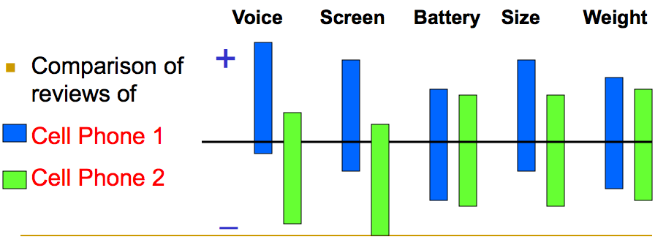
Introduction: What is Opinion Mining?
(Liu et al. 2005)
Notes:
google

Slide 6
Introduction: Sentiment Analysis
Opinion mining or sentiment analysis
Recognizing & Classifying Opinions
Why is it important?
Consumers: Key influencers of our behaviors
Business: Monitor consumer sentiment
Large Volume!!!!
-Bing Liu @ AAAI-2011, Aug. 8, 2011, San Francisco, USA
Notes:
Example: large volume

Slide 7
Easier and Harder Problems
Determining sentiments seems to be easier.
Sentence Level
I love this film! -- Pos It’s a waste of time! -- Neg
Document Level
This camera is a little heavy. But the lens is great! Overall, I love it very much! -- Pos
At first, the cooker works well. But after the first week, it didn’t work at all. I argued with the seller but till now get no responce. It is quite disturbing! -- Neg
Extracting entities and aspects is harder.
Combining them is even harder.

Slide 8
Harder Problems: Example
“This past Saturday, I bought a Nokia phone and my girlfriend bought a Motorola phone with Bluetooth. We called each other when we got home. The voice on my phone was not so clear, worse than my previous Samsung
phone. The battery life was short too. My girlfriend was quite happy with her phone. I wanted a phone with good sound quality. So my purchase was a real disappointment. I returned the phone yesterday.”
Orange-holder; Red-entity; Blue-aspect; Pink-sentiment

Slide 9
Aspect-based Opinion Summary
(Hu & Liu, 2004)
“I bought an iPhone a few days
ago. It is such a nice phone. The
touch screen is really cool. The
voice quality is clear too. It is
much better than my old
Blackberry, which was a terrible
phone and so difficult to type
with its tiny keys. However, my
mother was mad with me as I did
not tell her before I bought the
phone. She also thought the
phone was too expensive, …”
Feature Based Summary of iPhone:
Feature1: Touch screen
Positive: 212
The touch screen was really cool.
The touch screen was so easy to
use and can do amazing things.
…
Negative: 6
The screen is easily scratched.
I have a lot of difficulty in removing
finger marks from the touch screen.
…
Feature2: voice quality
…

Slide 10
Aspected-based Sentiment Analysis Procedure
Entities Extraction
Aspect Extraction
Aspect Synonyms Identification
Aspect Sentiment Classification
Notes:
repeat

Slide 11
Aspected-based Sentiment Analysis Procedure
Aspect Extraction
Aspect Synonyms Identification
Aspect Sentiment Classification
Notes:
repeat

Slide 12
Aspect Extraction
I bought an iPhone a few days ago. It is such a nice phone. The touch screen is really cool.
Aspect 1: touch screen
Aspect 2: voice
Aspect 3: keyboard
Aspect 4: price
The voice quality is clear too. It is much better than my old Blackberry, which was a terrible phone and so difficult to type with its tiny keys.
However, my mother was mad with me as I did not tell her before I bought the phone. She thought the phone was too expensive...

Slide 13
Aspect Extraction: Preprocessing
John saw the beautiful butterfly.
NNP VBD DT JJ NN
Part of Speech (POS) tagging
e.g.
Noun (person, place or thing)
Singular (NN): dog, fork
Plural (NNS): dogs, forks
Proper (NNP, NNPS): John, Springfields
Verb, Ajective, Adverb, Preposition, Determiner, Conjunction
Penn Treebank
Notes:
Different reviewers tell different stories (irrelevant)
When product features are discussed, the words that they use converge.
They are main features.

Slide 14
Aspect Extraction: Frequent
Frequency (Hu and Liu, 2004) (NN, NNS)
e.g. GREAT Camera., Jun 3, 2004
Reviewer: jprice174 from Atlanta, Ga.
The pictures coming out of this camera are amazing. The 'auto' feature takes great pictures most of the time. And the selfy function is also very great. …
How about the infrequent nouns?
Notes:
Different reviewers tell different stories (irrelevant)
When product features are discussed, the words that they use converge.
They are main features.

Slide 15

Aspect Extraction: Infrequent
Using part-of relationship and the Web
Better Precision (a small Drop in Recall).
Pointwise mutual information (PMI) score(Noun, Part Discriminators) using the Web
PMI (higher means more frequently be seen together)
Tend to co-occur : positive.
Presence – absence : negative.
e.g., a scanner class. (color; voice)
The part discriminators: “of scanner”, “scanner has”, “scanner comes with”, etc.
Notes:
hint for infrequent

Slide 16
Aspect Extraction: Infrequent
But the Performance is still not good?
precision of 79% and a recall of 76%
Domain dependent
We have another idea:
opinions have targets, i.e., opinion words are used to modify aspects and entities.
“The pictures are absolutely amazing.”
“This is an amazing software.”
Aspects approximated with the nearest noun to the opinion word.
But is it really true? Pictures from this camera are not good

Slide 17
Aspect Extraction: Using Double Propagation
(Qiu et al. 2009; 2011)
An opinion should have a target, entity or aspect.
Use dependency of opinions & aspects to extract both aspects & opinion words.
Knowing one helps find the other.
E.g., “The rooms are spacious”
It extracts both aspects and opinion words.
A domain independent method.
Notes:
strength&

Slide 18
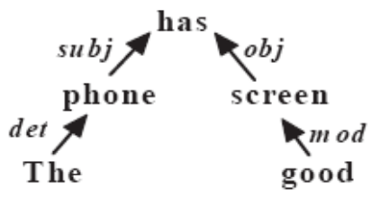
Aspect Extraction: Using Double Propagation
DP is a bootstrapping method.
Input: a set of seed opinion words, “good” “nice”
no aspect seeds needed.
Based on dependency grammar (Tesniere 1959).
“This phone has good screen”

Slide 19
Aspect Extraction: Using Double Propagation
Double Propagation
e.g.
“This phone has good screen”
Good -> Screen (Aspect words)
“The screen is very clear!”
Screen -> Clear (Opinion words)
“I like the picture of this phone is quite clear”
Clear -> ?????????????? (Aspect Words)

Slide 20
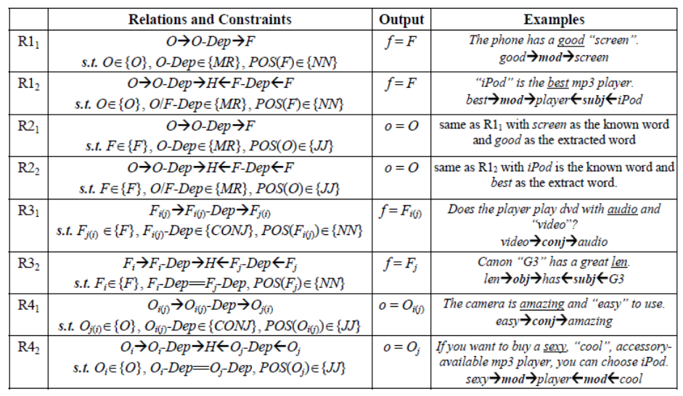
Aspect Extraction: Using DP - Dependency Rules

Slide 21
Aspected-based Sentiment Analysis Procedure
Aspect Extraction
Identify Aspect Synonyms
Aspect Sentiment Classification
Notes:
repeat

Slide 22
Identify Aspect Synonyms
Once aspect expressions are discovered, group them into aspect categories.
The power usage of iPhone 6 is much better than any previous generations.
The batter life of iPhone 6 has been remarkably improved and I can feel that! I do not need to charge it every day!
E.g., power usage and battery life are the same.

Slide 23
Identify Aspect Synonyms: WordNet
Using WordNet:  (Liu et al WWW-05)
Intuition:
Every two synonyms will be see as the same term!
But! Some errors may occur:
WordNet is general: (picture, movie)
In camera review: Picture ≢ Movie
word A and word B will be regarded as synonyms only if there is a synset containing A and B that appear in the top two senses of both words.

Slide 24
Identify Aspect Synonyms
(Zhai et al. 2011a, b)
Clustering features
Lexical similarity based on WordNet
Distributional information (surrounding words context)
co-occurrence of key phrases across review texts
battery life-longer, power-longer
Syntactical constraints (sharing words, in the same sentence)
battery life, battery, battery performance, power battery

Slide 25
Aspected-based Sentiment Analysis Procedure
Aspect Extraction
Identify Aspect Synonyms
Aspect Sentiment Classification
Notes:
repeat

Slide 26
Aspected-based Sentiment Analysis Procedure
In “Game of Thrones” (2011), the transition from book to screen is remarkbly successful.
Transition: +
Production: +
Cast: +
Plot: +
Narrative: +
Theme: -
The carefully chosen location and cast, the top-notch plot and the seamlessness of its narrative come together brilliantly.
I love this movie, even this is a rehashing old fantasy themes.

Slide 27
Aspect Sentiment Classification: Intuitition
Sentence level classification (Turney 2002)
Step 1: Part-of-speech (POS) tagging -> (1) JJ + NN.
Step 2: Sentiment orientation (SO) of the extracted phrases
SO(phrase) = PMI(phrase, “excellent”) - PMI(phrase, “poor”)
Bigger SO -> Positive
Step 3: Compute the average SO of all phrases -> +/-

Slide 28
Aspect Sentiment Classification: Intuitition
... the top-notch plot is really unforgetable.
JJ + NN RB + JJ
PMI(“top-notch plot”, “excellent”) = 2.780
PMI(“top-notch plot”, “poor”) = 0.110
SO(“top-notch plot”) = 2.670
PMI(“really unforgetble”, “excellent”) = 0.629
PMI(“really unforgetble”, “excellent”) = 0.237
SO(“really unforgetble”)=0.392
mean(SO)=(2.670+0.392)/2=3.062 > threshold => positive
(By training)

Slide 29
Aspect Sentiment Classification
But…
When the sentence is quite complex (using but, and, if, not)
e.g.
The carefully chosen location and cast, the top-notch plot and the seamlessness of its narrative come together brilliantly.

Slide 30
Aspect Sentiment Classification: Lexicon-based
Lexicon-based
Ding, Liu and Yu, 2008)
Output: opinion to an aspect +, -, or neutral.
Two steps:
Step 1: split the sentence (but, except that, etc).
Step 2: work on the segment sf containing a.

Slide 31
Summary
Aspect Extraction
Frequency
Part-of-Relationship (Aspects are not always frequent)
DP (Inprove Precision & Recall, Domain Independent)
Identify Aspect Synonyms
Lexical similarity (WordNet)
Distributional information (Domain Independent)
Syntactical constraints (Accuracy Improved)
Aspect Sentiment Classification
Intuitive Sentence-level
Lexicon-based (Separate sentence & Domain Independent)
Notes:
repeat

Slide 32
Questions?
Aspect Extraction
Frequency
Part-of-Relationship
DP
Identify Aspect Synonyms
Lexical similarity
Distributional information
Syntactical constraints
Aspect Sentiment Classification
Intuitive Sentence-level
Supervised
Lexicon-based

Slide 33
Appendix

Slide 34
Background: Quintuples
(Liu. 2012)
(e_{j}, a_{jk}, so_{ijkl}, h_{i}, t_{l}),
e_{j} - a target entity: Named Entity Extraction (more)
a_{jk} – an aspect of ej: Information Extraction
so_{ijkl} is sentiment: Sentiment Identification
h_{i} is an opinion holder: Information/Data Extraction
t_{l} is the time: Information/Data Extraction
5 pieces of information must match
From Unstructured to Structured!

Slide 35
Aspect Sentiment Classification:
Classification (Snyder et al. 2007, Wei et al. 2010)
Feature: unigrams and bigrams; contrastive distance
Ex: “delicious” and “dirty” have high contrast,
while “expensive” and “slow” would have low contras
Method: SVM
Limitations
Needs training data
Dependent on the domain

Slide 36
Aspect Sentiment Classification
Lexicon-based approach (Ding, Liu and Yu, 2008)
Need parsing to deal with: Simple sentences, compound sentences, comparative sentences, conditional sentences, questions; different verb tenses, etc.
Negation (not), contrary (but), comparisons, etc.
+ but -, - but +
Not + = -
A large opinion lexicon, context dependency, etc.
“Apple is doing well in this bad economy.”
We can get Opinion Words!

